Slide 1
Django App (Part - 5)
Django basic to pro course in Nepali .

Slide 2
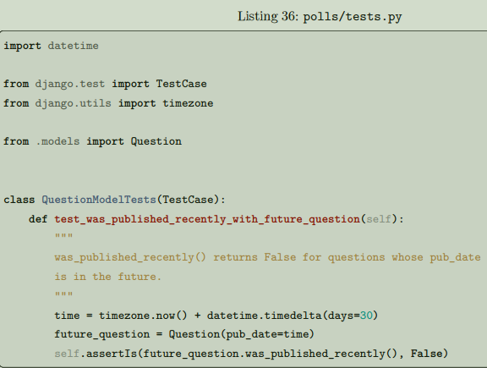
Introducing automated testing
- What are automated tests?
What’s different in automated tests is that the testing work is done for you by the system. You create a set of tests once, and then as you make changes to your app, you can check that your code still works as you originally intended, without having to perform time consuming manual testing.
Basic testing strategies
Sometimes it’s difficult to figure out where to get started with writing tests. If you have written several thousand lines of Python, choosing something to test might not be easy. In such a case, it’s fruitful to write your first test the next time you make a change, either when you add a new feature or fix a bug. So, let’s do that right away.
Create a test to expose the bug
What we’ve just done in the shell to test for the problem is exactly what we can do in an automated test, so let’s turn that into an automated test. A conventional place for an application’s tests is in the application’s tests.py file; the testing system will automatically find tests in any file whose name begins with test. Put the following in the tests.py file in the poll's application:

Slide 3
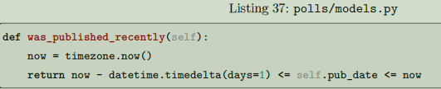
Here we have created a django.test.TestCase subclass with a method that creates a Question instance with a pub_date in the future. We then check the output of was_published_recently() - which ought to be False.
Running tests
In the terminal, we can run our test:
$ python manage.py test polls
What happened is this:
• manage.py test polls looked for tests in the poll's application
• it found a subclass of the django.test.TestCase class
• it created a special database for the purpose of testing
• it looked for test methods - ones whose names begin with test
• in test_was_published_recently_with_future_question it created a Question instance whose
pub_date field is 30 days in the future
• . . . and using the assertIs() method, it discovered that its was_published_recently() returns True,
though we wanted it to return False
Fixing the bug
We already know what the problem is: Question.was_published_recently() should return False if its
pub_date is in the future. Amend the method in models.py, so that it will only return True if the date is also
in the past:
More comprehensive tests
While we’re here, we can further pin down the was_published_recently() method; in fact, it would be positively embarrassing if in fixing one bug we had introduced another. Add two more test methods to the same class, to test the behavior of the method more comprehensively

Slide 4
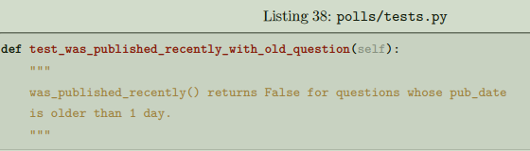
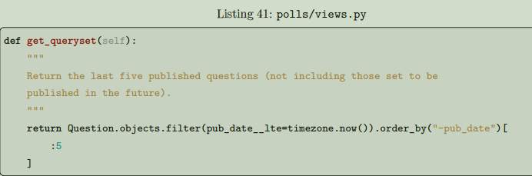
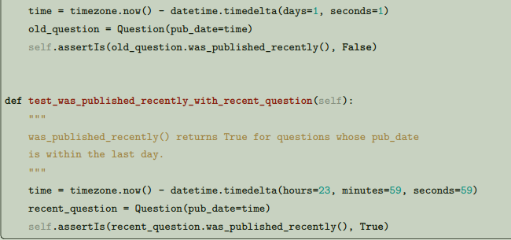
Testing our new view
Now you can satisfy yourself that this behaves as expected by firing up runserver, loading the site in your browser, creating Questions with dates in the past and future, and checking that only those that have been published are listed. You don’t want to have to do that every single time you make any change that might affect this - so let’s also create a test, based on our shell session above.
Improving our view
The list of polls shows polls that aren’t published yet (i.e., those that have a pub_date in the future). Let’s fix that.

Slide 5
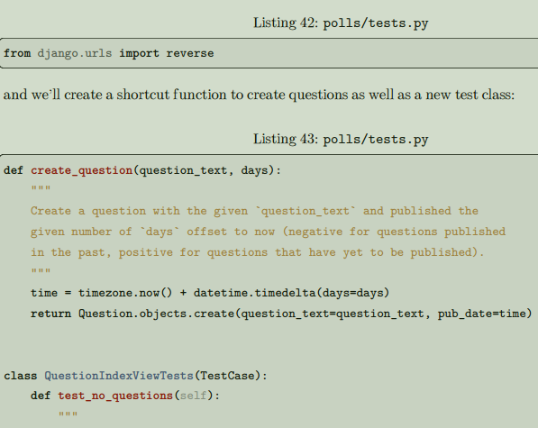
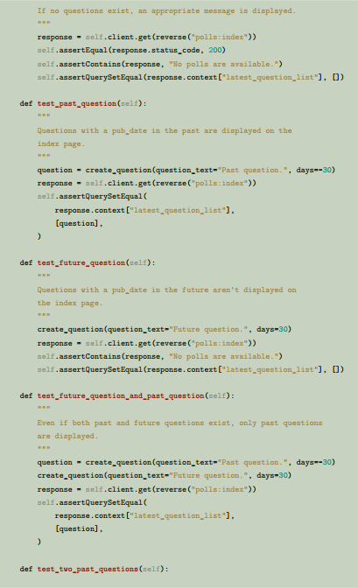

Slide 6
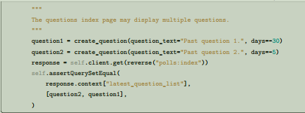
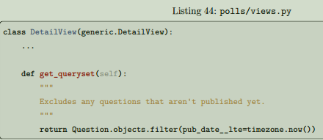
Testing the DetailView
What we have works well; however, even though future questions don’t appear in the index, users can still reach them if they know or guess the right URL. So we need to add a similar constraint to DetailView:
Let’s look at some of these more closely.
First is a question shortcut function, create_question, to take some repetition out of the process of creating questions.test_no_questions doesn’t create any questions, but checks the message: “No polls are available.” and verifies the latest_question_list is empty. Note that the django.test.TestCase class provides some additional assertion methods. In these examples, we use assertContains() and assertQuerySetEqual(). In test_past_question, we create a question and verify that it appears in the list. In test_future_question, we create a question with a pub_date in the future. The database is reset for
each test method, so the first question is no longer there, and so again the index shouldn’t have any questions in it. And so on. In effect, we are using the tests to tell a story of admin input and user experience on the site, and checking that at every state and for every new change in the state of the system, the expected results are published.

Slide 7
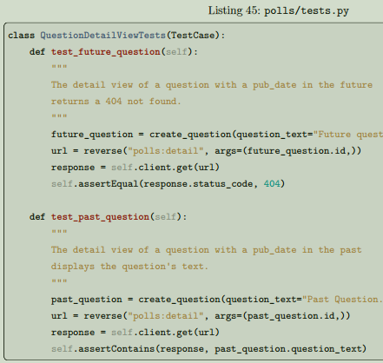
We should then add some tests, to check that a Question whose pub_date is in the past can be displayed,
and that one with a pub_date in the future is not:

Slide 8
Thank you for watching 💖

